Slide 1


Theory of ultrafast dynamics in superconductors
  PRB 92, 224517 (2015)
  PRB 93, 144506 (2016)
Collaborators:
A. F. Kemper, B. Moritz, J. K. Freericks, T. P. Devereaux,
A. Georges, C. Kollath
Michael Sentef
New3SC-11, Bled, September 14, 2016

Slide 2
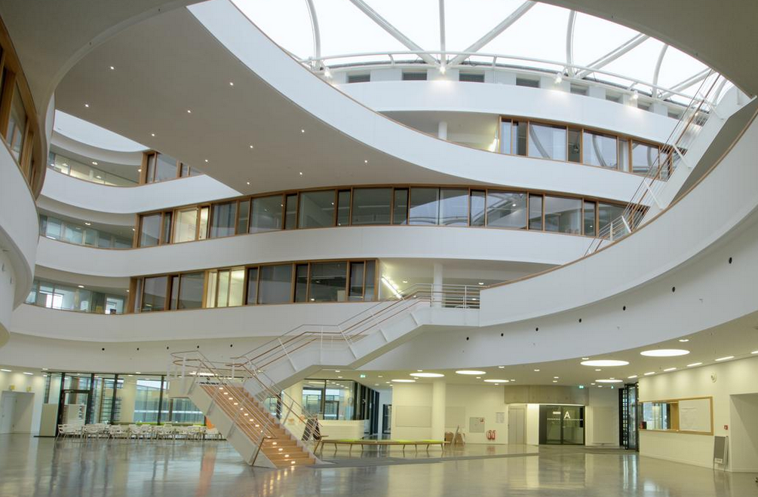
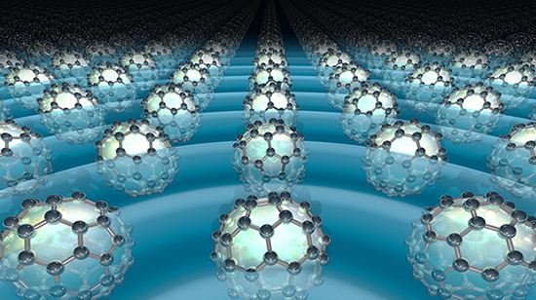
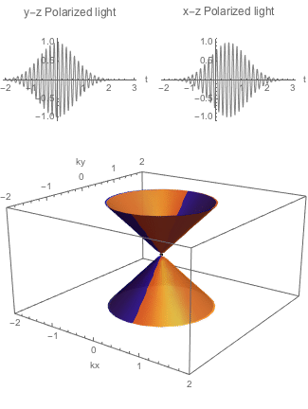
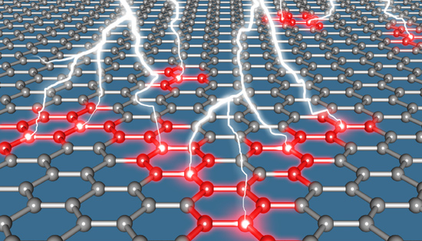
MPI for the Structure and Dynamics of Matter, Hamburg

Slide 3
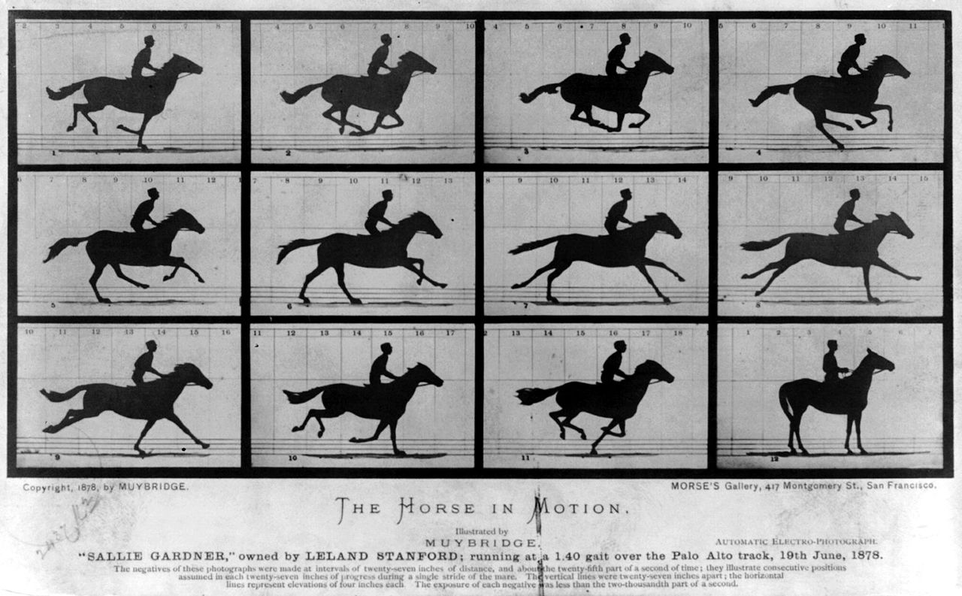

Pump-probe spectroscopy (1887)
stroboscopic investigations of dynamic phenomena
Muybridge 1887

Slide 4
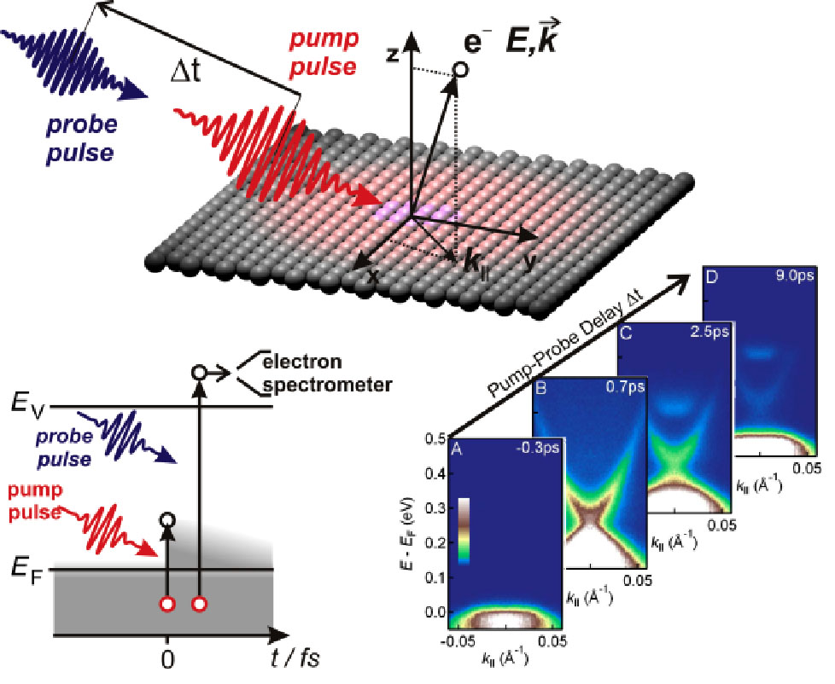
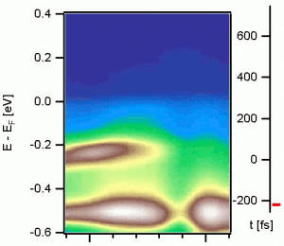
Pump-probe spectroscopy (today)
stroboscopic investigations of dynamic phenomena
TbTe3 CDW metal
J. Sobota et al., PRL 108, 117403 (2012)
F. Schmitt et al., Science 321, 1649 (2008)
Image courtesy: J. Sobota / F. Schmitt

Slide 5
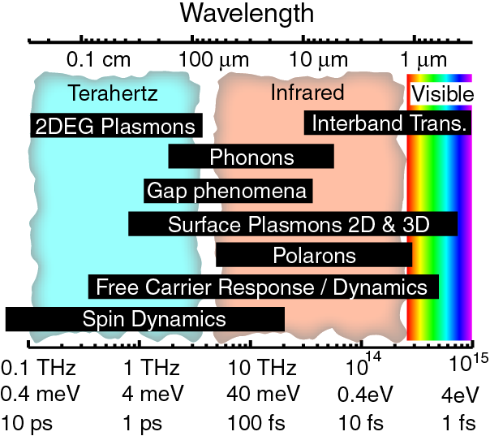
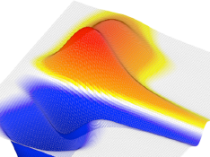
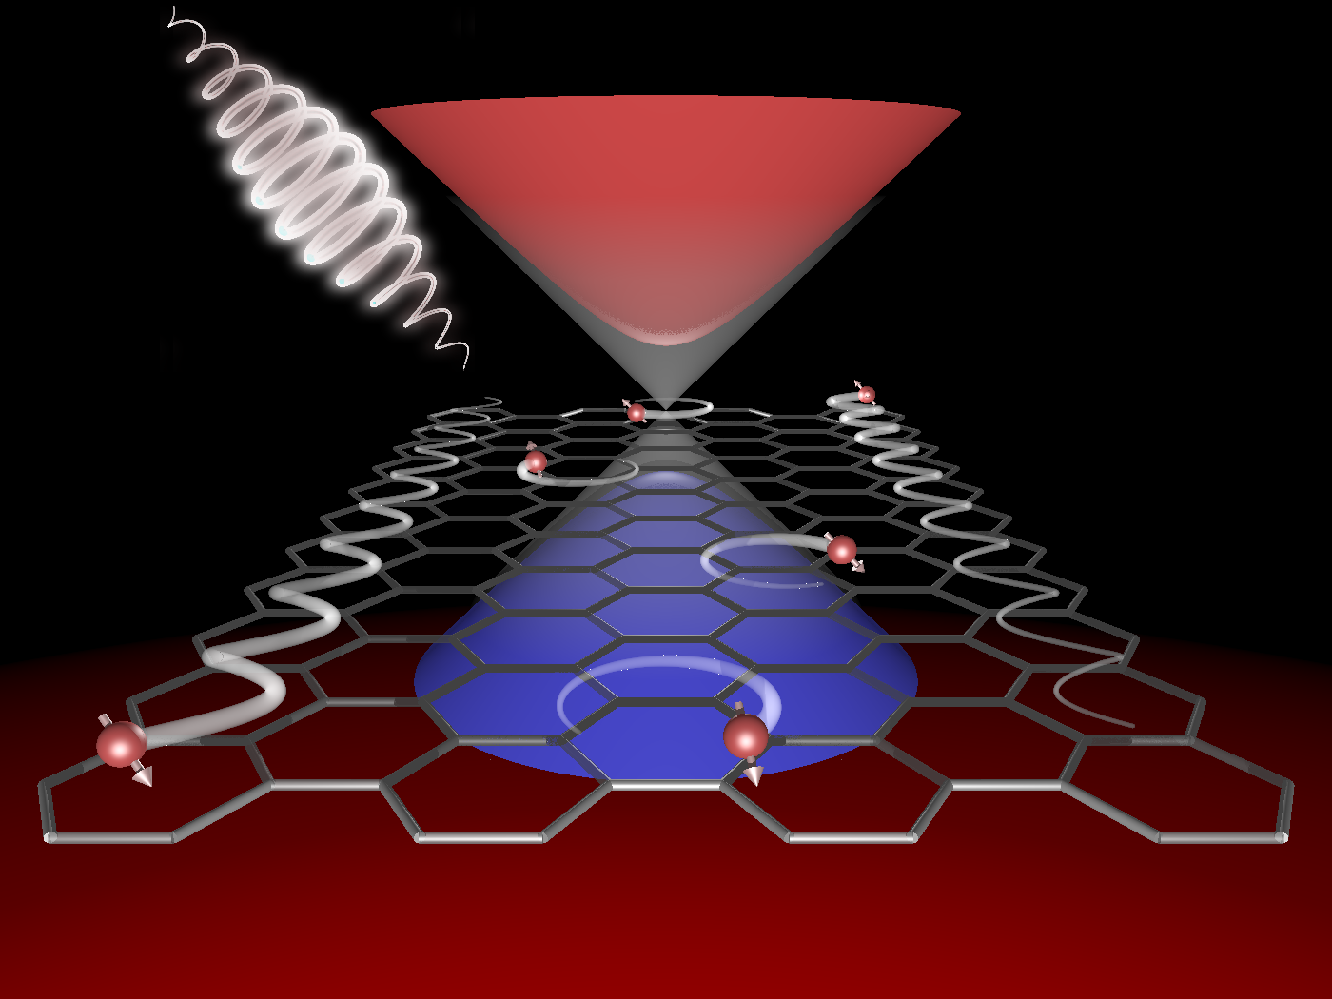
Ultrafast Materials Science
Understanding the nature of quasiparticles
Relaxation dynamics
  PRL 111, 077401 (2013)
  PRX 3, 041033 (2013)
  PRB 87, 235139 (2013)
  PRB 90, 075126 (2014)
  arXiv:1505.07055
  arXiv:1607.02314
Understanding ordered phases
Collective oscillations
Competing order parameters
  PRB 92, 224517 (2015)
  PRB 93, 144506 (2016)
Creating new states of matter
Photo-induced phase transitions
Floquet topological states
Image courtesy:
D. Basov
  Nature Commun. 6, 7047 (2015)
  arXiv:1604.03399
Notes:
The first question that you may ask already at this point: Why does one want to do ultrafast materials science in the first place?
There are several answers: To understand how complex quantum materials work, one needs to understand elementary excitations above the equilibrium state. These excitations, however, span large time and energy scales, as highlighted in this picture of typical scales in solids.
COMPLEMENTARITY between time and energy tells us that excitations that are hard to resolve in one domain are much more easily resolved in the other domain. So even for LINEAR RESPONSE, going to the time domain provides an additional tool.
Then, collective emergent states of many electrons and many ions arise due to complicated interactions. I will show an example where we understand the nature of quasiparticles and their coupling to one dominant bosonic mode from a time-domain pump-probe spectroscopy, which may have important implications for the understanding of high-temperature superconductivity, one of the holy grails of solid-state physics yet unsolved.
The understanding of ordered states automatically leads to the question: Can we not only learn about ordering mechanisms, but also about how we can control ordered states and enhance orderings? This would be important also for applications – think of room-temperature superconductivity as a long-term goal. In particular, the delicate balance between competing orders, where one suppresses the other, and how to change this game with a laser pulse is of central importance in the field.
And, finally, it is a no-brainer that we need to go out of equilibrium to understand new states of matter that only exist when we pump the system, such as inducing nonequilibrium phase transitions or Floquet states that I will describe in the last part of my talk.

Slide 6
Outline
Keldysh Green functions
Ordered states: Driven superconductors
  Higgs amplitude mode oscillations for optical pumping (1.5 eV laser)
  light-enhanced superconductivity via hopping control
  PRB 92, 224517 (2015)
PRB 93, 144506 (2016)

Slide 7
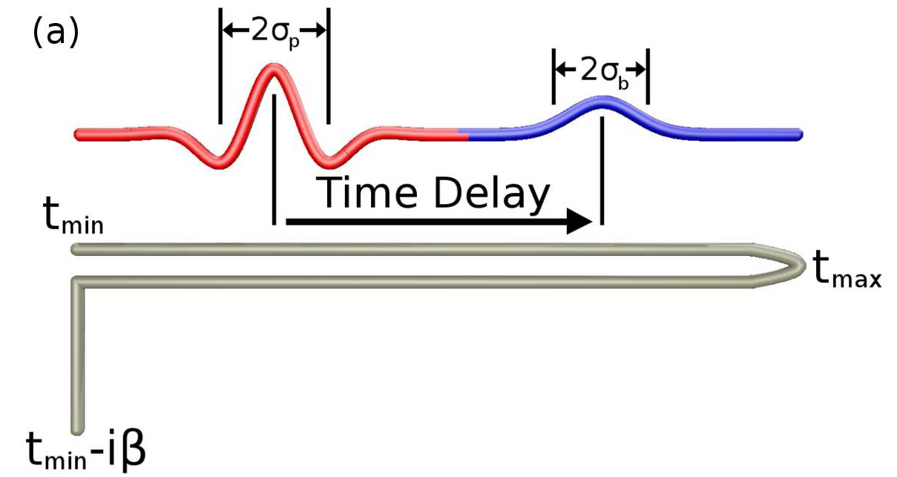
Non-Equilibrium Keldysh Formalism
Beyond BCS
self-energy Σ:
electron-electron scattering
electron-phonon scattering
...
Include the effects of driving field through time-dependent electronic dispersion
…and about its history
System knows about its thermal initial state…

Slide 8
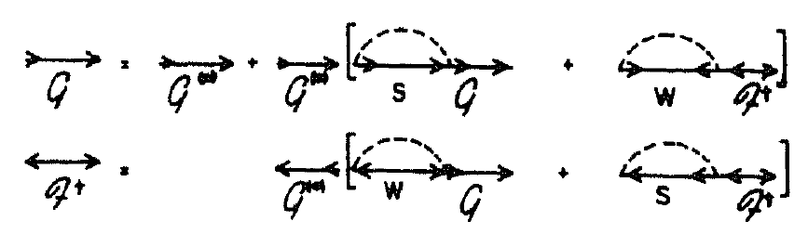
Model and Method
electrons (2D square latt.) + spectrum of phonons + el-ph coupling (Holstein)
Migdal-Eliashberg (1st Born) + phonon heat bath approximation
superconductor:
normal
anomalous
order parameter Δ,
condensate dynamics
el-ph single-particle
scattering
also see:
Murakami, Werner et al., PRB 93, 094509 (2016)

Slide 9
Higgs amplitude mode
Include the effects of driving field through Peierls substitution

Slide 10
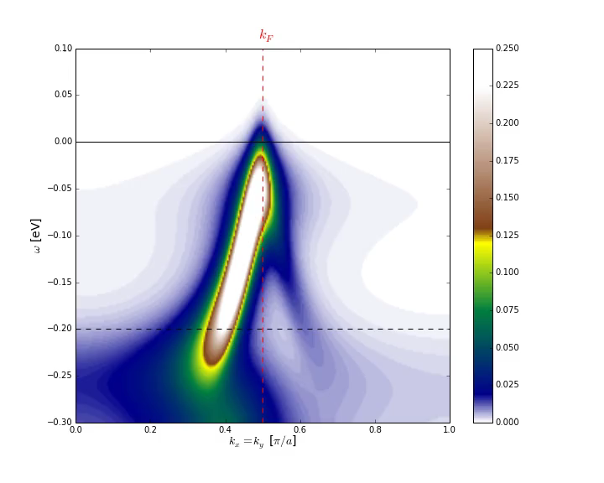
Oscillations in photocurrent

Slide 11
Amplitude mode oscillations
  PRB 92, 224517 (2015)
Amplitude (“Higgs”) mode oscillations predicted in time-resolved ARPES
Reduced order parameter sets oscillation frequency
Dissipation: Exciting Higgs even far away from gap resonance
Optics: Matsunaga et al., Phys. Rev. Lett. 111, 057002 (2013), Science 2014 [10.1126/science.1254697]
Theory: Volkov & Kogan 1974, Barankov PRL 2004, Yuzbashyan PRL 2006, Tsuji PRL 2013, Murakami PRB 2016, Schnyder, Manske et al, PRB 2011, Krull, Manske et al., PRB 2014

Slide 12

How to enhance boson-mediated SC?
BCS theory – plain vanilla SC (weak coupling)
  effective attraction V₀ ~ g²/(ħ Ω)
  e-boson coupling g
  boson frequency Ω
  electronic DOS N(E_{F})
Ω
Σ =
g
N(E_{F})
g
Migdal-Eliashberg theory
boson-mediated pairing

Slide 13
How to enhance boson-mediated SC?
nonlinear phononics Q²Q: resonant excitation of vibrational modes – effects?
tune model parameters
  e-boson coupling g
  boson frequency Ω
  electronic DOS N(E_{F})
dynamical effect
  effective Hamiltonian (e.g., Floquet)
}
α²F – Eliashberg function
Gedankenexperiment (what if?)
also see: Knap et al., arXiv:1511.07874,
Patel & Eberlein PRB 93, 195139 (2016), Komnik & Thorwart arXiv:1607.03858

Slide 14
Classical lattice dynamics
THz light pulse
Rectification of a second (Raman) phonon via coherent driving of a first (IR) phonon
„Nonlinear phononics“
M. Först et al., Nature Physics 7, 854 (2011)
A. Subedi, A. Cavalleri, A. Georges, PRB 89, 220301R (2014)

Slide 15
Classical lattice dynamics
THz light pulse
Displaced Raman mode assumed to lead to temporal change of electronic hopping
Gedankenexperiment (what if?)
Include the effects of driving field through time-dependent electronic dispersion
„Nonlinear phononics“
M. Först et al., Nature Physics 7, 854 (2011)
A. Subedi, A. Cavalleri, A. Georges, PRB 89, 220301R (2014)

Slide 16
Experimental motivation
„Possible light-induced superconductivity in K3C60 at high temperature“
M. Mitrano et al., Nature 530, 461 (2016)

Slide 17
Simplest model: hopping ramp
Equilibrium picture:
Enhancement of SC via enhanced DOS at Fermi energy

Slide 18
Superconductor evolution
Enhancement of SC strongly depends on initial thermal state

Slide 19
Enhancement during ramp
Order parameter enhancement ~Δ₀
time scale to fully enhance long-range order diverges at T_{c}!

Slide 20
Superconductor evolution
dashed: no dissipation (BCS only)
Dissipation helps enhancement for fast ramps

Slide 21
Dynamically enhanced coupling?
  I. Gierz et al,
  arXiv:1607.02314
  enhanced electron-phonon coupling in a periodically distorted graphene lattice driven on resonance with IR phonon

Slide 22
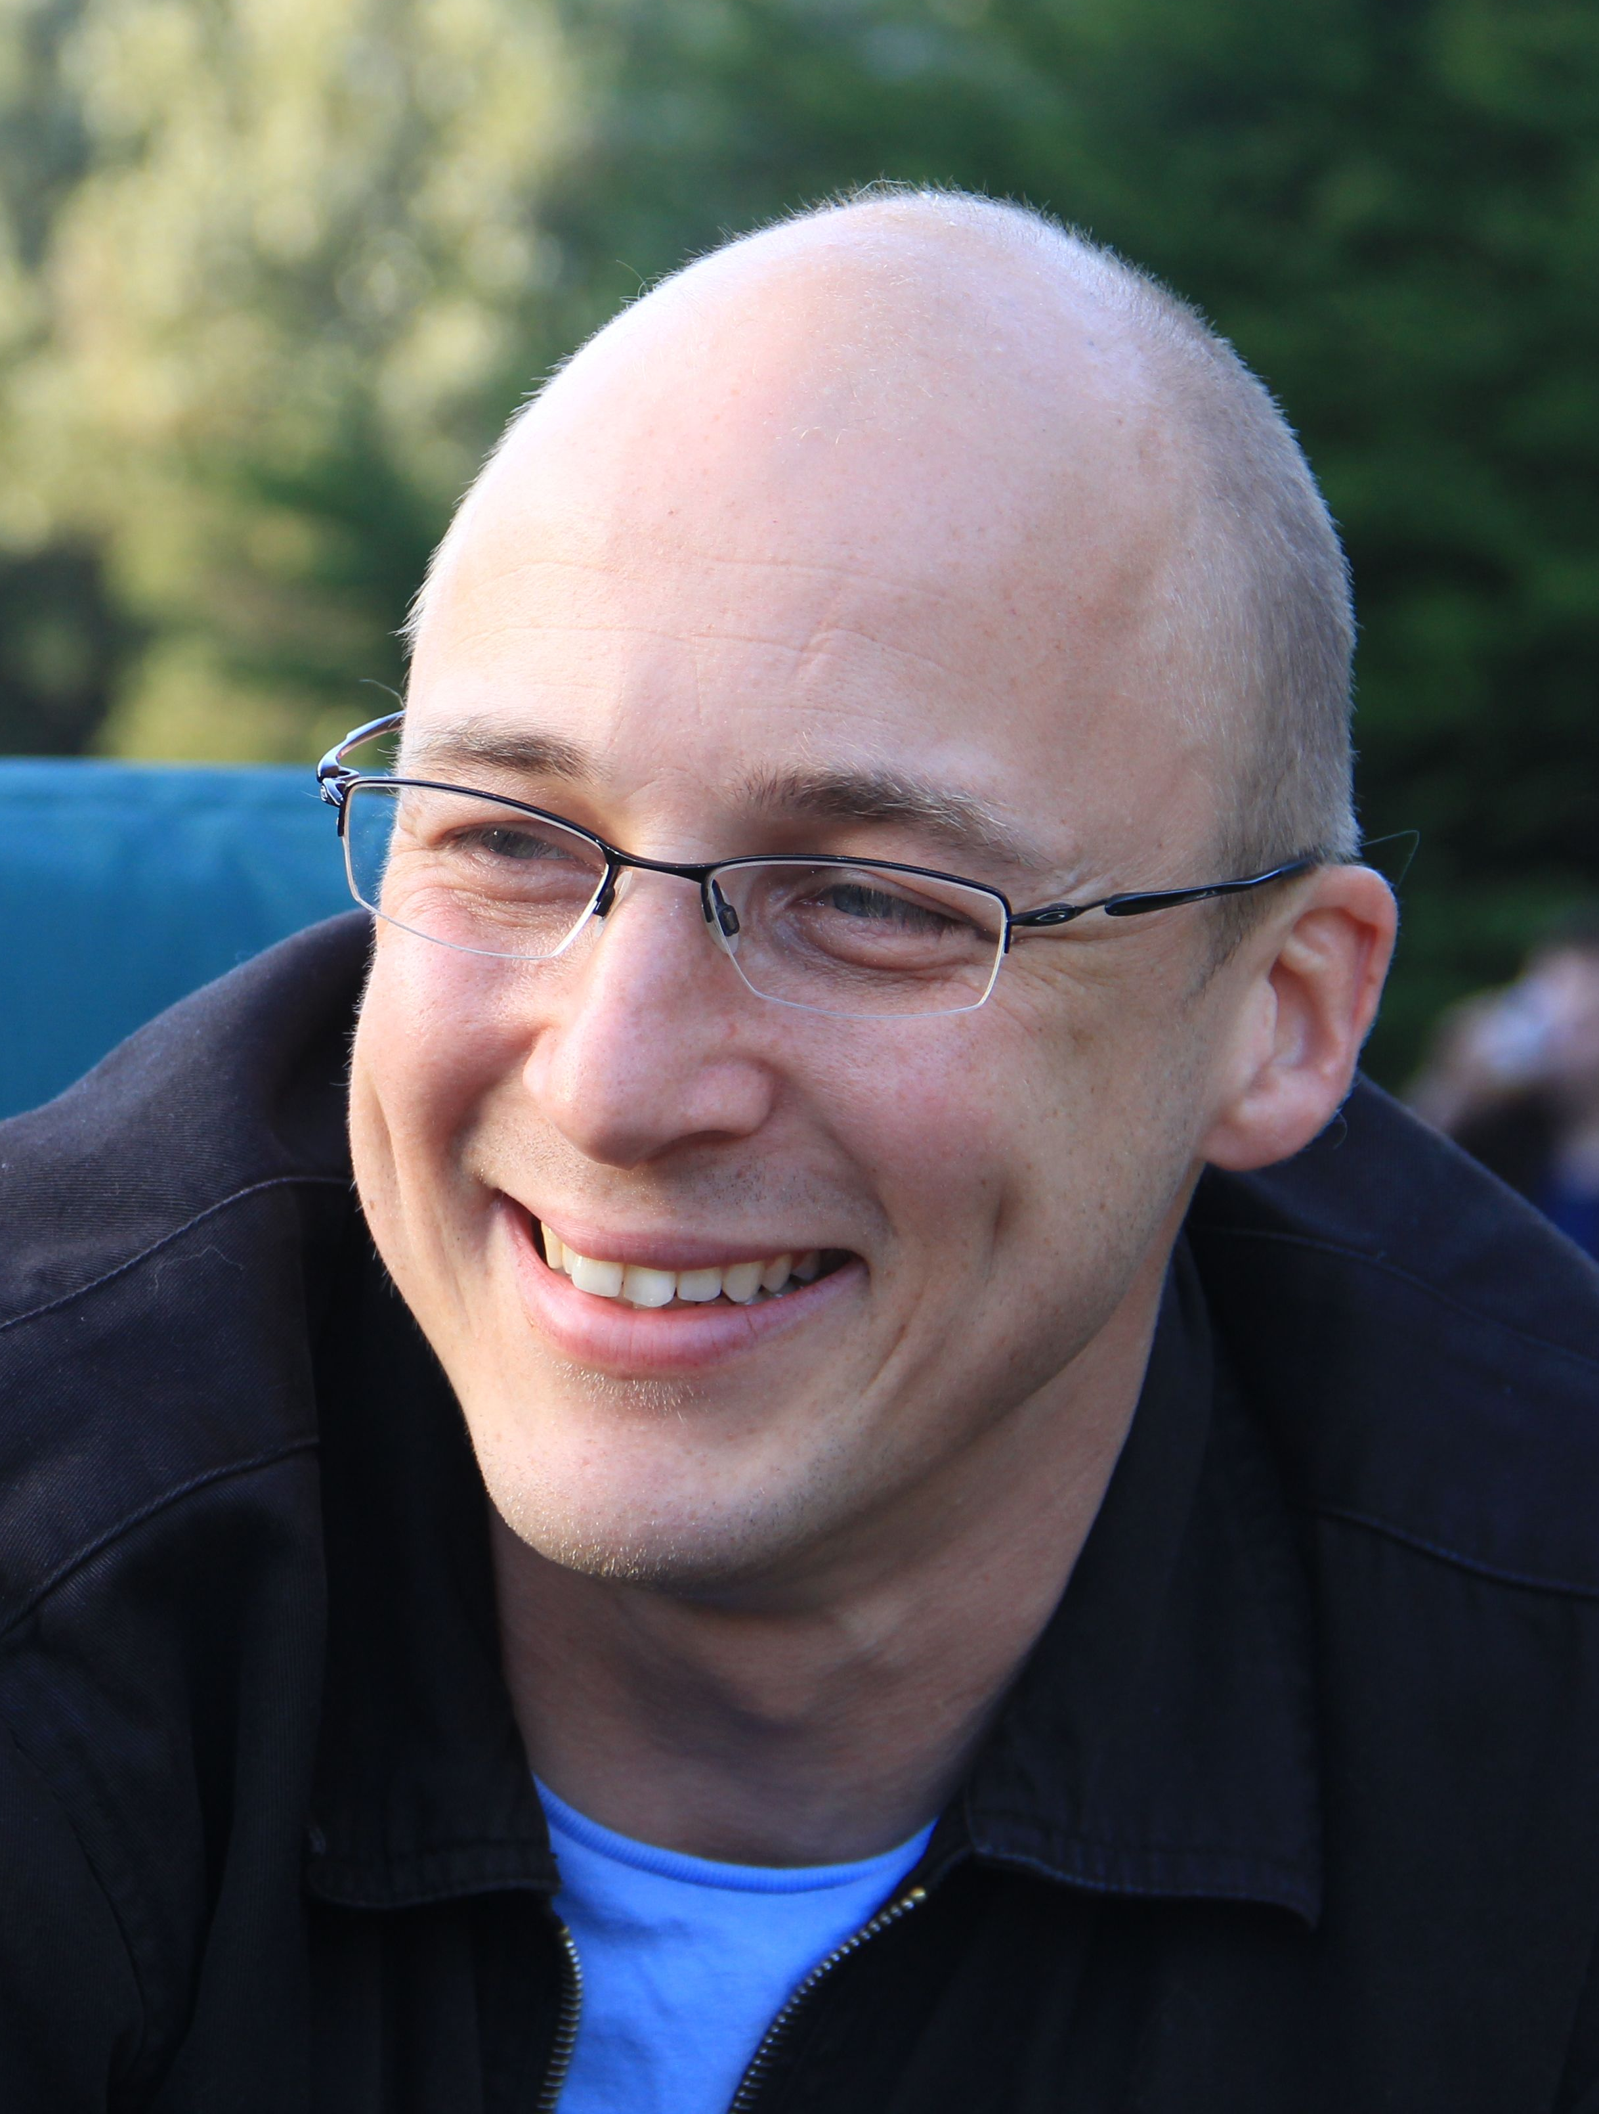



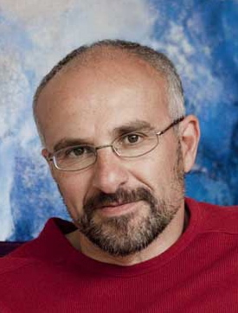





Summary
Amplitude mode oscillations in pumped SC
Light-enhanced SC via nonlinear phononics
  PRB 92, 224517 (2015)
PRB 93, 144506 (2016)
  A. F. Kemper T. P. Devereaux B. Moritz J. K. Freericks A. Georges C. Kollath

Slide 24
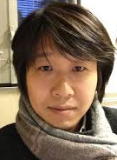
Theory of laser-controlled competing orders
Akiyuki Tokuno, Antoine Georges, Corinna Kollath
(Paris/Bonn)

Slide 25
Ultrafast order
Why?
understand ordering mechanisms
control ordered states
induce new states of matter
How?
resonance with something
Is there a generic mechanism to control ordered states?

Slide 26
Driven SC/CDW
CDW ~ A
1-photon resonance
Ω
2Δ

Slide 27
Driven SC/CDW
CDW ~ A
1-photon resonance
SC ~ A²
2-photon resonance
Ω
Ω
2Δ
2Δ
Ω

Slide 28
Driven SC/CDW
CDW ~ A
1-photon resonance
SC ~ A²
2-photon resonance
Ω
Ω
2Δ
2Δ
Ω
CDW
SC

Slide 29
Driven SC/CDW
CDW ~ A
1-photon resonance
SC ~ A²
2-photon resonance
Ω
Ω
2Δ
2Δ
Ω
CDW
... laser lifts SC/CDW degeneracy
SC

Slide 30
Driven SC/CDW
CDW ~ A
1-photon resonance
SC ~ A²
2-photon resonance
Ω
Ω
2Δ
2Δ
Ω
CDW
... laser lifts SC/CDW degeneracy
... Goldstone-like collective mode?
SC

Slide 31
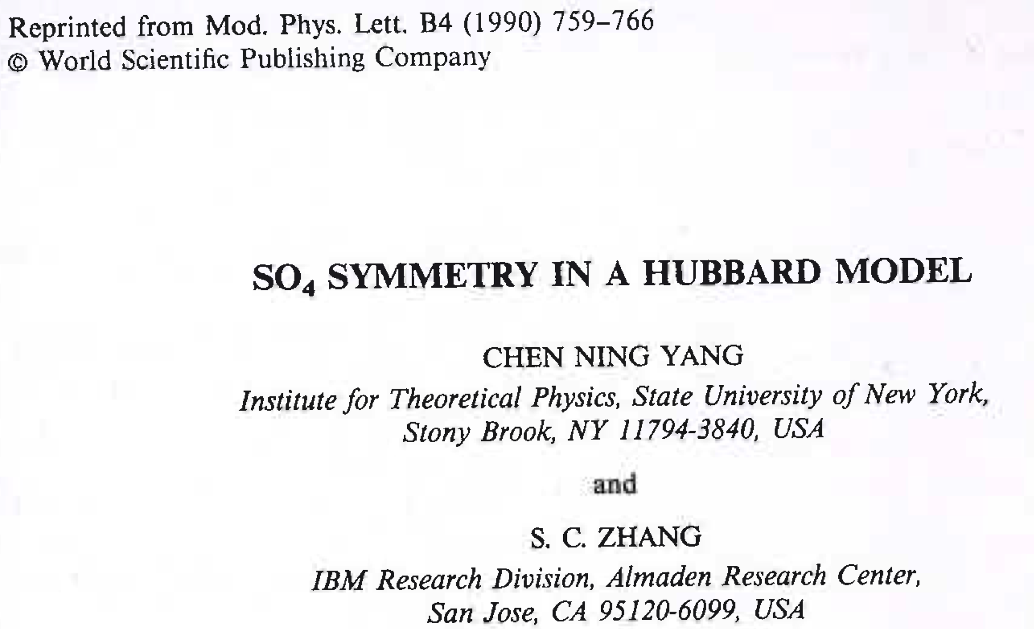

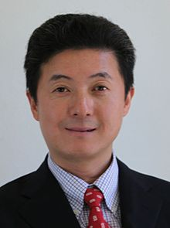
Competing orders
CDW
- attractive -U Hubbard model
- degeneracy of SC and CDW at perfect nesting
- SO(4) symmetry (SC, CDW, eta pairing)
SC
C. N. Yang
(1957 Nobel for parity violation in weak interaction)
S.-C. Zhang
(Topological Insulators)

Slide 32

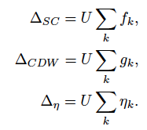
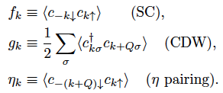
Simplistic Model
attractive U + mean-field decoupling

Slide 33
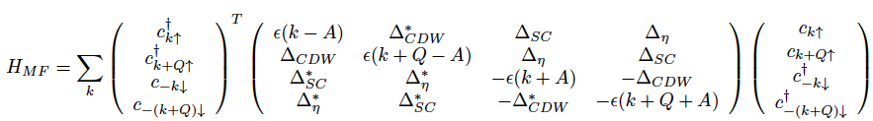
Mean-field Hamiltonian
4x4 matrix: SO(4) algebra

Slide 34


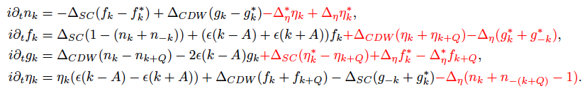
Mean-field equations
eta pairing provides coupling
nonlinear equations + self-consistency:

Slide 35
Laser hits degenerate orders

Slide 36
Gap resonance – cw driving
Below resonance:
SC down, CDW up
CDW
SC

Slide 37
Gap resonance – cw driving
Above resonance:
SC up, CDW down
CDW
SC

Slide 38
Gap resonance – cw driving
Above resonance:
SC up, CDW down
CDW
SC
imaginary in gauge where SC is real

Slide 39
Gap resonance – cw driving
oscillation frequency set by light-induced eta pairing amplitude, which gives „mass“ to collective mode
resonant behavior at Ω=2Δ

Slide 40
Can we bring SC alive?

Slide 41
Can we bring SC alive?
CDW initial state
SC comes alive!

Slide 42
Can we bring SC alive? – pulsed field
CDW initial state
SC comes alive!

Slide 43
What controls the dynamics?
Short times: laser control
Long times: dissipation?
Questions:
Can we use dissipation to stabilize SC?
Nondegenerate case?

Slide 44
Summary part 2
laser-controlled switching between SC/CDW
light-induced eta pairing and a collective mode
light-induced long-lived superconductivity possible?
?

