Slide 1


Theoretical simulations of pump-probe spectroscopies in solids
Michael A. Sentef
lab.sentef.org
Max-Planck Institute for the Structure and Dynamics of Matter, Hamburg
DPG Spring Meeting, Dresden, March 2017

Slide 2
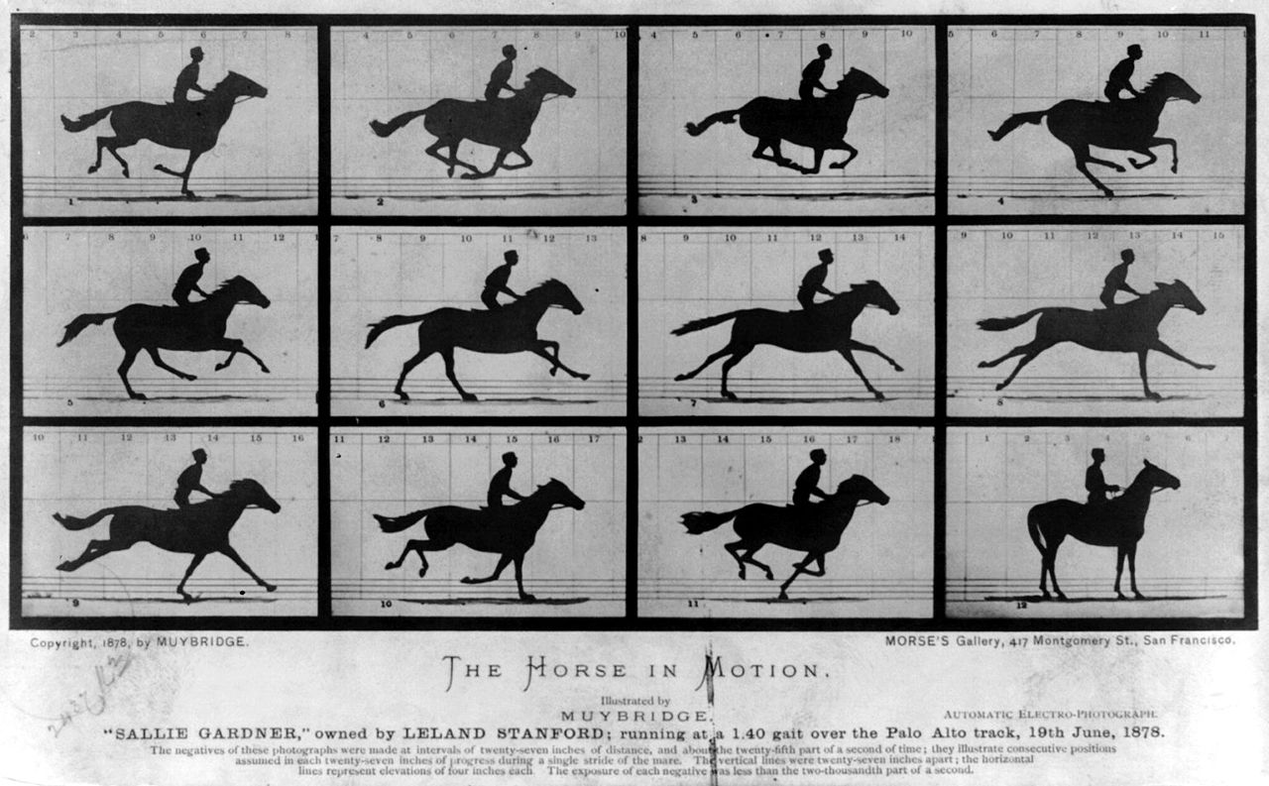

Pump-probe spectroscopy (1887)
stroboscopic investigations of dynamic phenomena
Muybridge 1887

Slide 3
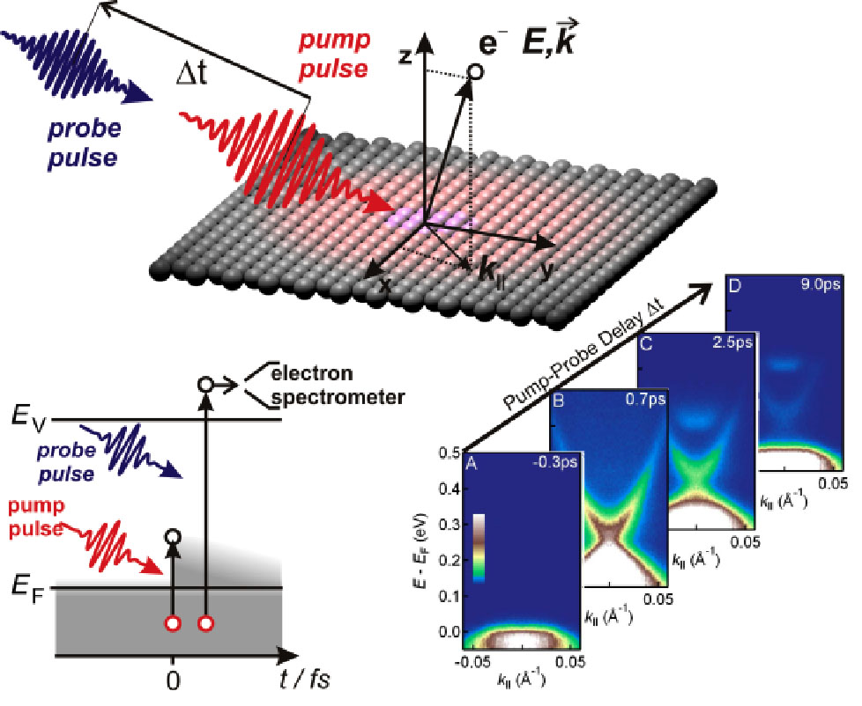
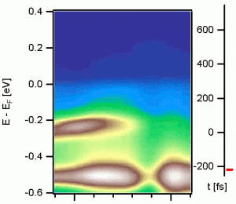
Pump-probe spectroscopy (today)
stroboscopic investigations of dynamic phenomena
TbTe3 CDW metal
Image courtesy:
J. Sobota / F. Schmitt

Slide 4
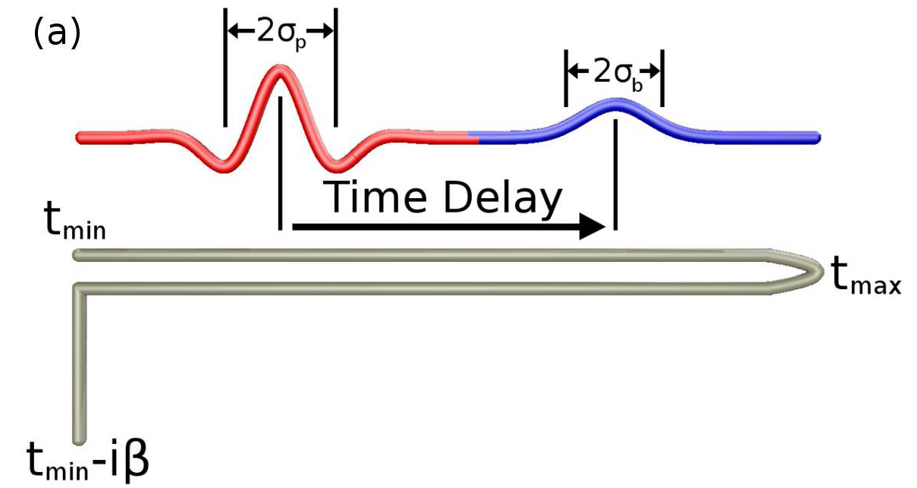
Non-Equilibrium Keldysh Formalism
self-energy Σ:
electron-electron scattering
electron-phonon scattering
...
same problem as in equilibrium (but worse):
use your favorite self-energy approximation, e.g. perturbation theory, nonequilibrium DMFT, ...
Include the effects of driving field through time-dependent electronic dispersion
…and about its history
System knows about its thermal initial state…

Slide 5
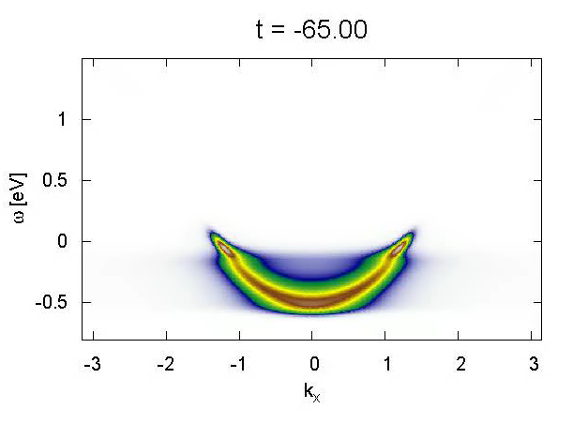

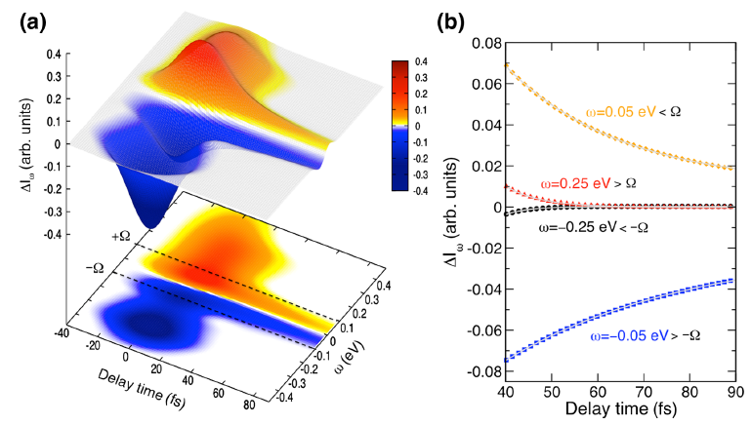
Electron-boson coupling
  PRX 3, 041033 (2013)
Weak pump
Strong pump
time unit = 0.66 fs
boson window effect for fast versus slow relaxation
nonlinear response for strong pump

Slide 6
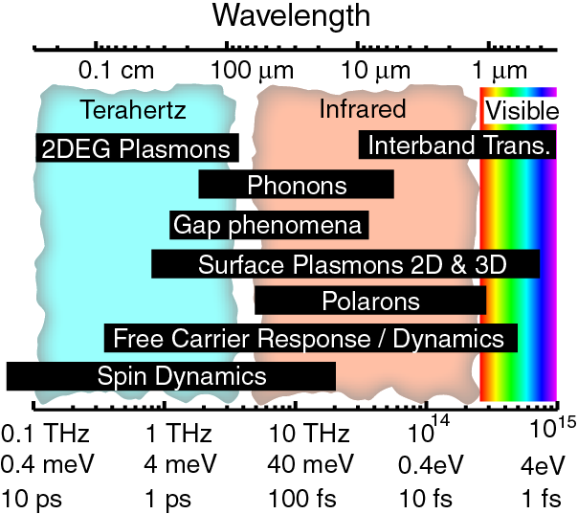
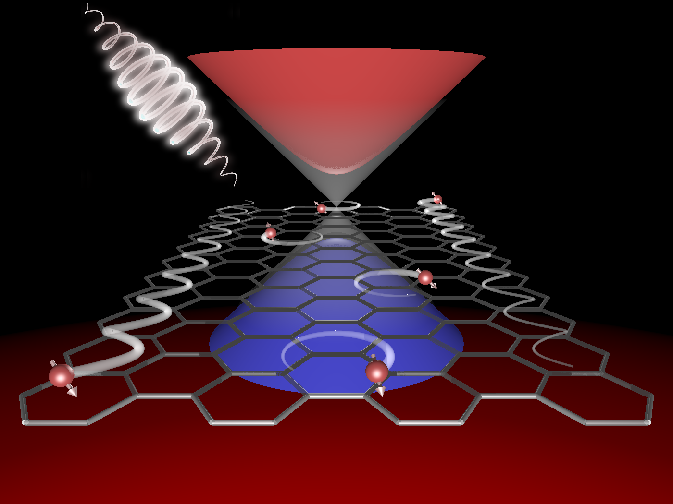
Ultrafast Materials Science today
Understanding the nature of quasiparticles
Relaxation dynamics
Control of couplings
  PRL 111, 077401 (2013)
  PRX 3, 041033 (2013)
  PRB 87, 235139 (2013)
  PRB 90, 075126 (2014)
  Nature Commun. 7, 13761 (2016)
  PRB 95, 024304 (2017)
  arXiv:1702.00952
Understanding ordered phases
Collective oscillations
Competing order parameters
  PRB 92, 224517 (2015)
  PRB 93, 144506 (2016)
  PRL 118, 087002 (2017)
Creating new states of matter
Photo-induced phase transitions
Floquet topological states
Image courtesy:
D. Basov
  Nature Commun. 6, 7047 (2015)
  Nature Commun. 8, 13940 (2017)
Notes:
The first question that you may ask already at this point: Why does one want to do ultrafast materials science in the first place?
There are several answers: To understand how complex quantum materials work, one needs to understand elementary excitations above the equilibrium state. These excitations, however, span large time and energy scales, as highlighted in this picture of typical scales in solids.
COMPLEMENTARITY between time and energy tells us that excitations that are hard to resolve in one domain are much more easily resolved in the other domain. So even for LINEAR RESPONSE, going to the time domain provides an additional tool.
Then, collective emergent states of many electrons and many ions arise due to complicated interactions. I will show an example where we understand the nature of quasiparticles and their coupling to one dominant bosonic mode from a time-domain pump-probe spectroscopy, which may have important implications for the understanding of high-temperature superconductivity, one of the holy grails of solid-state physics yet unsolved.
The understanding of ordered states automatically leads to the question: Can we not only learn about ordering mechanisms, but also about how we can control ordered states and enhance orderings? This would be important also for applications – think of room-temperature superconductivity as a long-term goal. In particular, the delicate balance between competing orders, where one suppresses the other, and how to change this game with a laser pulse is of central importance in the field.
And, finally, it is a no-brainer that we need to go out of equilibrium to understand new states of matter that only exist when we pump the system, such as inducing nonequilibrium phase transitions or Floquet states that I will describe in the last part of my talk.

Slide 7
Outline
Part I: Floquet engineering of topological solids
  Floquet Chern insulator in graphene
  Floquet-Weyl semimetal in Na₃Bi
  Nature Commun. 6, 7047 (2015)
Nature Commun. 8, 13940 (2017)
Part II: Light-enhanced electron-phonon coupling
Part III: Laser-controlled competing orders
  PRB 95, 024304 (2017)
  arXiv:1702.00952
  PRL 118, 087002 (2017)
„as time permits“

Slide 8
I. Floquet engineering in solids

Slide 9
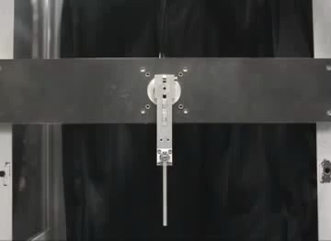
Driven is different
Kapitza pendulum
youtube.com/watch?v=tP88f-SwO_E
dynamical stabilization of a metastable state
Notes:
Different regimes depending on driving frequency and amplitude

Slide 10
Driven is interesting
-> infinity
Kapitza class, dynamical stabilization
Bukov, d‘Alessio, Polkovnikov, Adv. Phys. 64, 139-226 (2015)
-> finite but largest scale
Floquet engineering
-> resonances
sidebands, huge effects, detuning
-> smallest
dc physics, adiabatic evolution

Slide 11
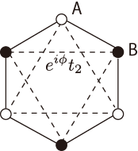
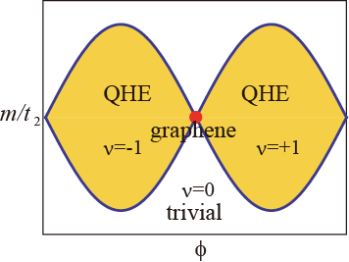
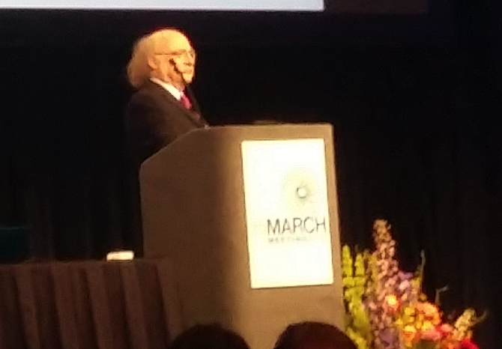
Floquet topological states
Graphene + circularly polarized light (breaks trs)
Haldane model (PRL 61, 2015 (1988))
breaks inv
?
pump
Local flux φ
Staggered field m
Fictitious fields!
breaks trs
Duncan Haldane
@APS 2017

Slide 12



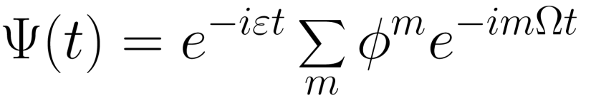
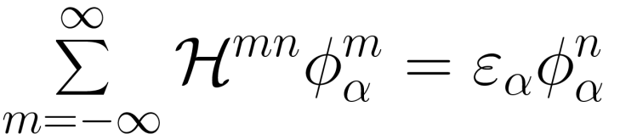
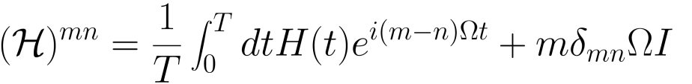

Floquet engineering in a nutshell
time periodic system
“Floquet mapping”
= Bloch state in time
Floquet Hamiltonian (static eigenvalue problem)
ε: Floquet quasi-energy
~ absorption of m “photons”
slides courtesy of Takashi Oka

Slide 13
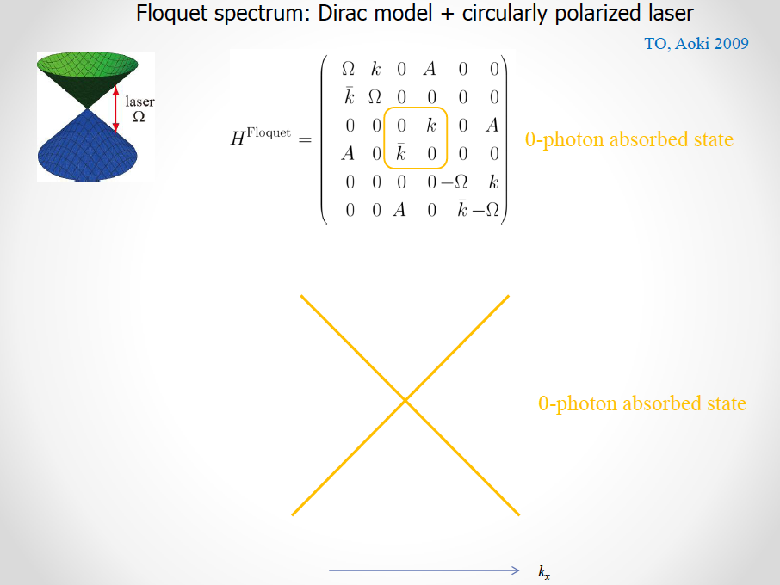

Slide 14
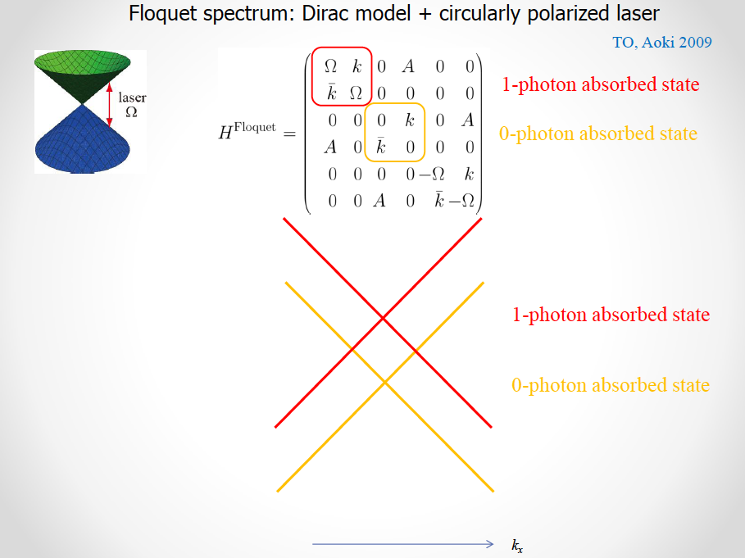

Slide 15
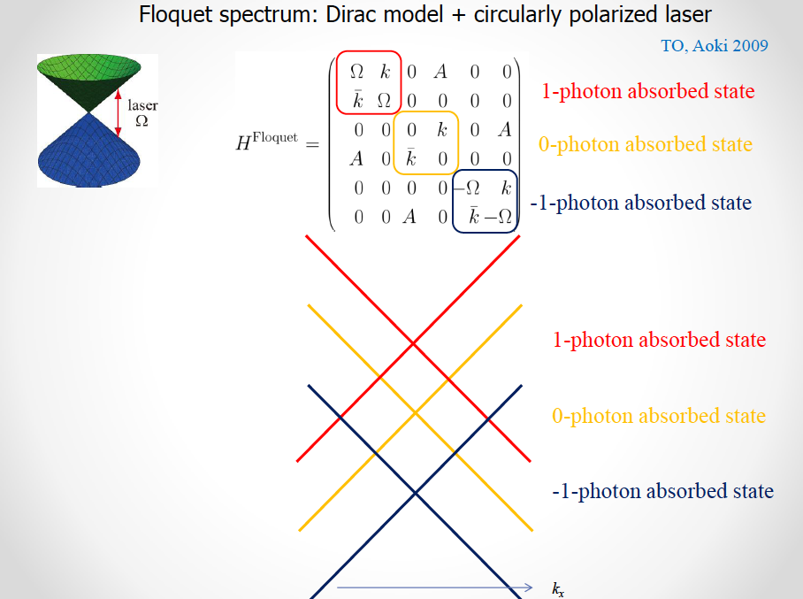

Slide 16
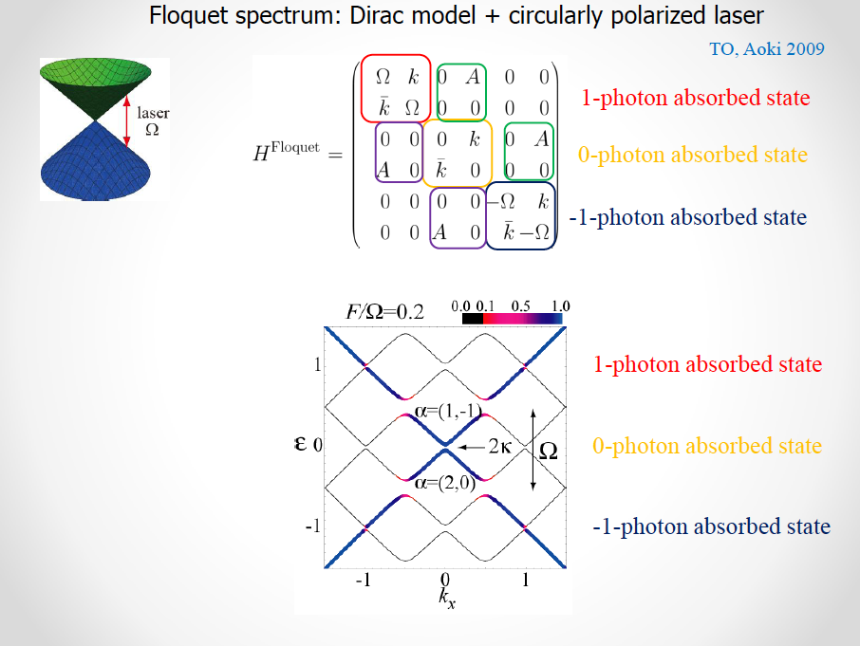

Slide 17
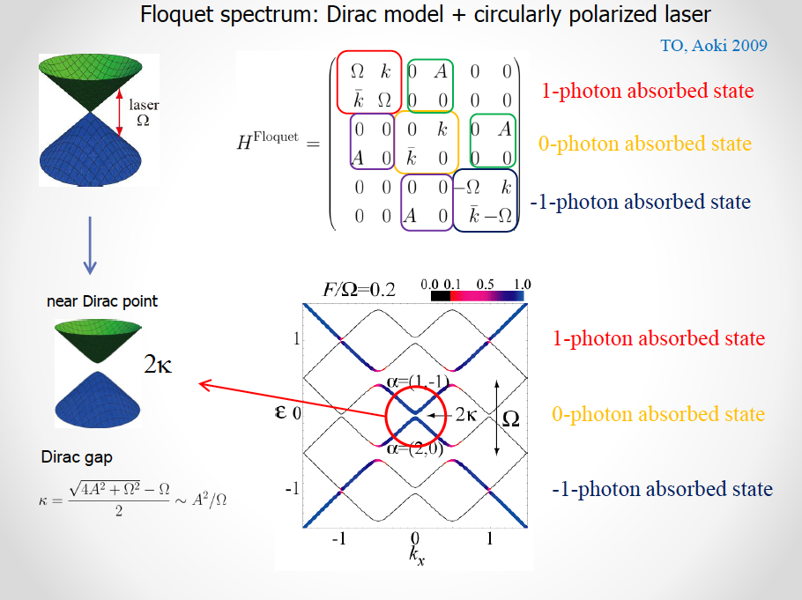

Slide 18
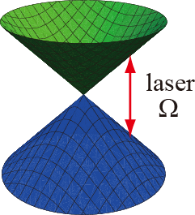
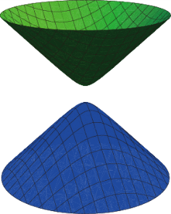


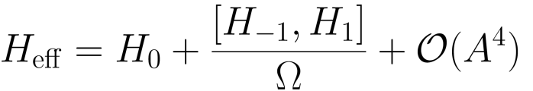
Dirac fermion + circularly polarized laser
Mass term = energy gap =
synthetic field stemming from a real time-dependent field A(t)
Floquet engineering
Kapitza
Oka and Aoki,
PRB 79, 081406 (2009)

Slide 19
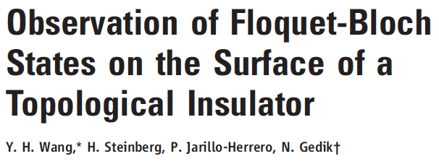
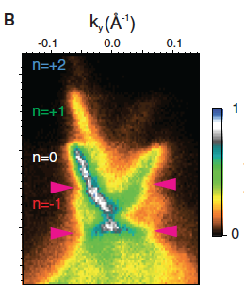
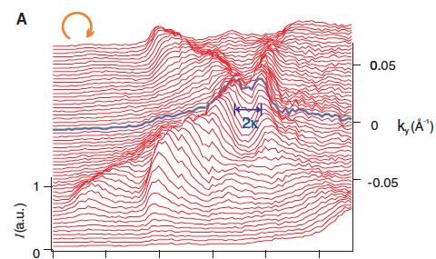
Bi₂Se₃
Science 342, 453 (2013)
Binding energy
momentum
Binding energy

Slide 20
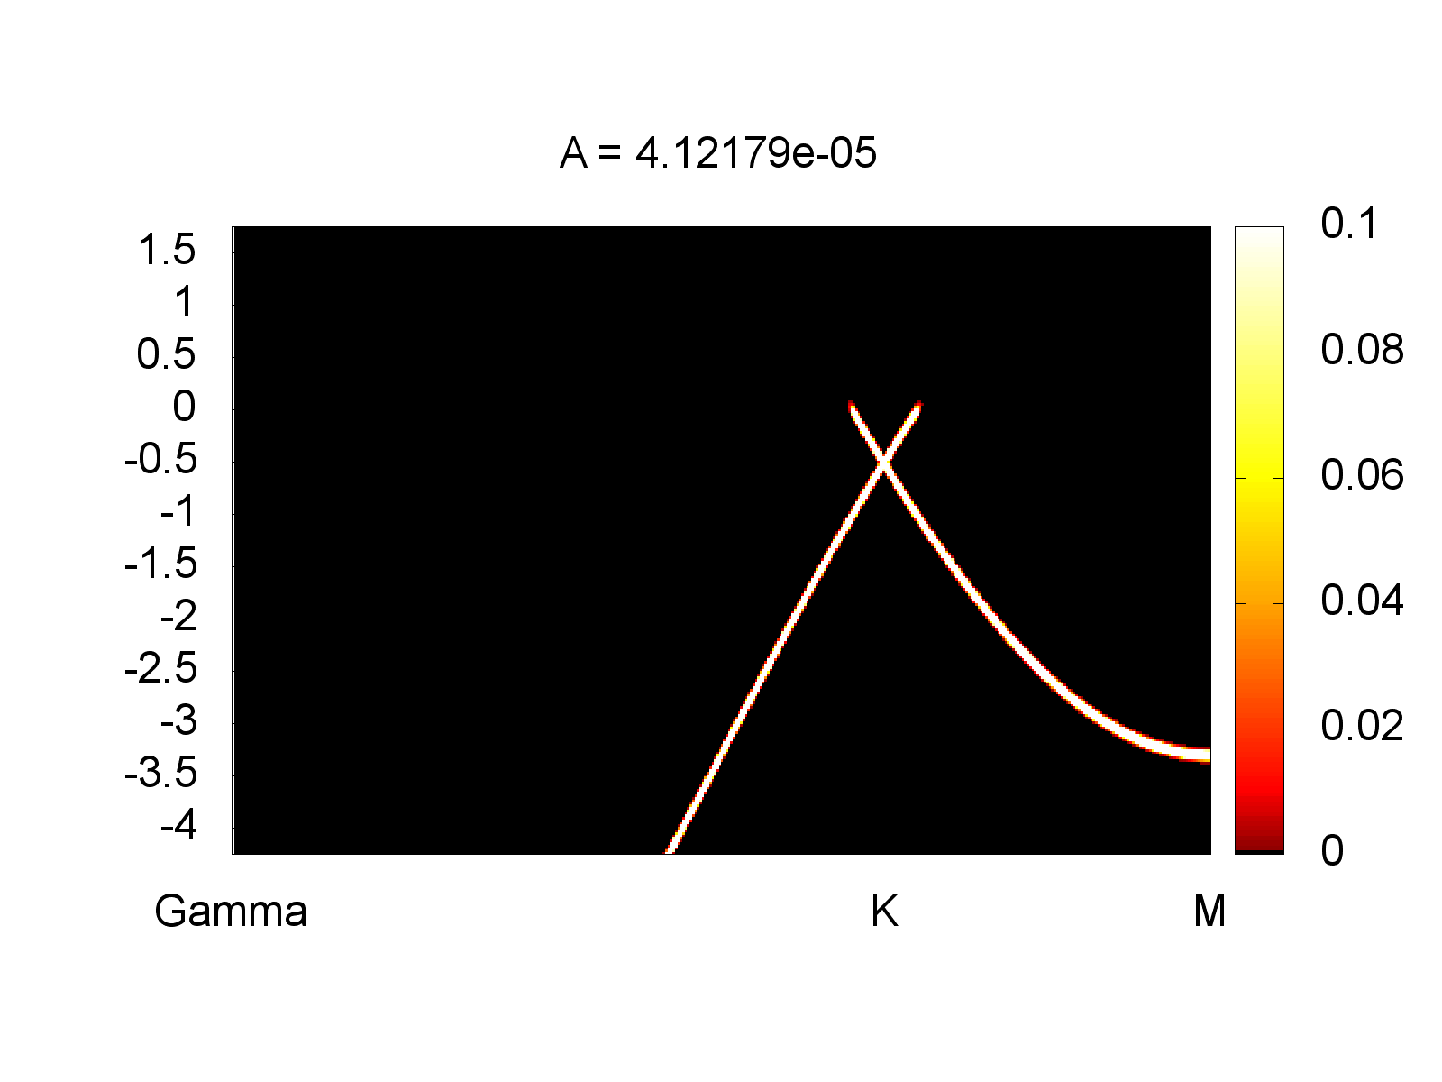
Floquet-Bloch states in graphene
Tight-binding model + nonequilibrium Keldysh formalism:
Time-resolved ARPES during 1.5 eV circularly polarized laser pulse
Turning graphene into a Chern insulator
Floquet engineering
binding energy in eV
Resonances, sidebands
momentum
  M. A. Sentef, M. Claassen, A. F. Kemper, B. Moritz, T. Oka, J. K. Freericks, and T. P. Devereaux, Nature Commun. 6, 7047 (2015)

Slide 21
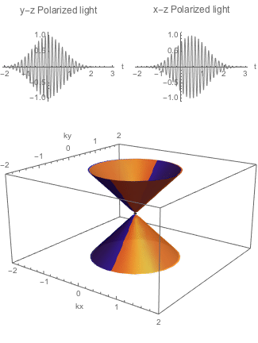
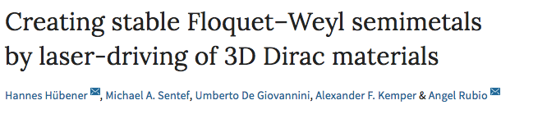
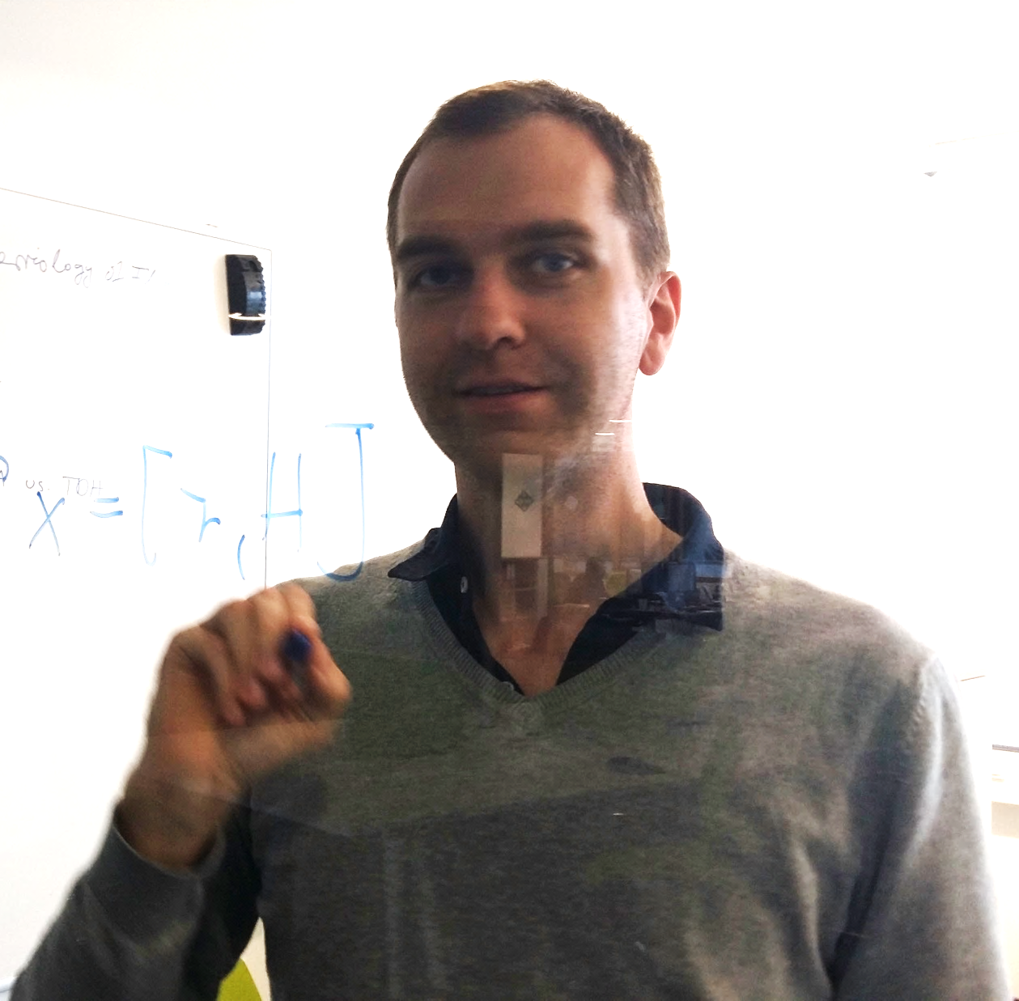
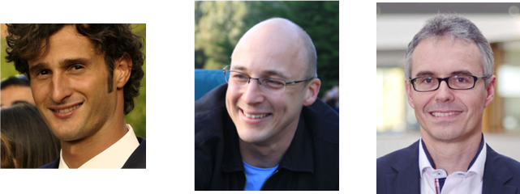
Floquet-Weyl semimetal
Ab initio: TDDFT + Floquet theory
Nature Commun. 8, 13940 (2017)
Hannes Hübener
Umberto de Giovannini
Alexander Kemper
(NC State)
Angel Rubio
Notes:
Different regimes depending on driving frequency and amplitude

Slide 22
Summary I
Floquet engineering: tuning effective parameters and changing materials properties by laser driving
  Nature Commun. 6, 7047 (2015)
Nature Commun. 8, 13940 (2017)

Slide 23
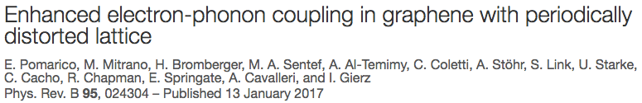
II Dynamically enhanced coupling
  PRB 95, 024304 (2017)
  enhanced electron-phonon for pump on resonance with IR phonon

Slide 24
Dynamically enhanced coupling?
  PRB 95, 024304 (2017)
  transient reduction of Drude weight
  enhanced tr-ARPES relaxation
  3-fold enhancement of effective λ_{el-ph}! Why?

Slide 25
2-site model with nonlinear coupling
  arXiv:1702.00952
also cf.
Kennes et al.,
Nature Physics (2017),
1609.03802
Idea: Drive nonlinearly coupled phonon and look at electronic response
Drive:
Response:

Slide 26
Time-resolved el spectrum
  arXiv:1702.00952
Reduced coherence peaks with stronger driving
Looks like enhanced el-ph coupling
light-induced polaron formation

Slide 27
Field scaling
  arXiv:1702.00952
Theory
Data by E. Pomarico,
unpublished
Scaling of coherent spectral weight loss: proportional to field intensity consistent with experiments

Slide 28


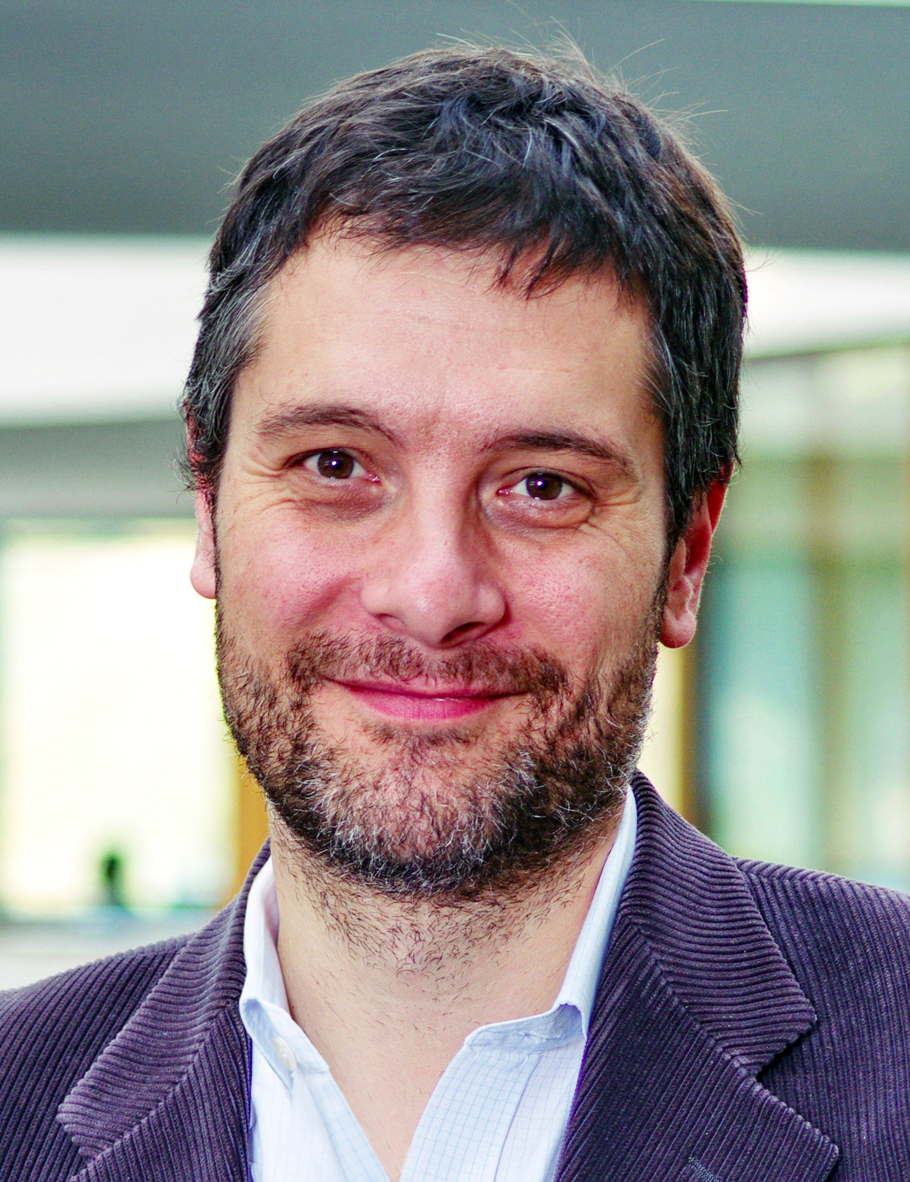
Summary II
enhanced electron-phonon coupling in phononically driven bilayer graphene
  PRB 95, 024304 (2017)
  E. Pomarico I. Gierz A. Cavalleri
Exact solution of (small) electron-phonon model system:
theoretical proposal: nonlinear el-ph coupling as mechanism behind this enhancement
  arXiv:1702.00952

Slide 29
Summary
From models to materials:
theoretical simulations enable us to reveal mechanisms behind ultrafast dynamics in solids
THANK YOU!

Slide 30
III Theory of laser-controlled competing orders
  Phys. Rev. Lett. 118, 087002 (2017)

Slide 31
Nonequilibrium superconductivity
Why?
understand ordering mechanisms
control ordered states: ultrafast switching
induce new states of matter
How?
laser near resonance with collective modes
Generic mechanism to control competing orders with light?
Recent theories on laser-controlled couplings and competing orders:
Akbari et al., EPL 101, 17003 (2013); Moor et al., PRB 90, 024511 (2014); Fu et al., PRB 90, 024506 (2014); Dzero et al., PRB 91, 214505 (2015); Tsuji&Aoki, PRB 92, 064508 (2015); Cea et al., PRB 93, 180507 (2016); Kemper et al., PRB 92, 224517 (2015); Sentef et al., PRB 93, 144506 (2016); Krull et al., Nat. Commun. 7, 11921 (2016); Patel&Eberlein, PRB 93, 195139 (2016); Knap et al., PRB 94, 214504 (2016); Komnik&Thorwart EPJB 89, 244 (2016); Coulthard et al., 1608.03964; Kennes et al., Nat. Physics (2017), doi:10.1038/nphys4024; Sentef, 1702.00952; Babadi et al. 1702.02531; Murakami et al.,1702.02942; Mazza&Georges, 1702.04675; Dehghani&Mitra, 1703.01621

Slide 32
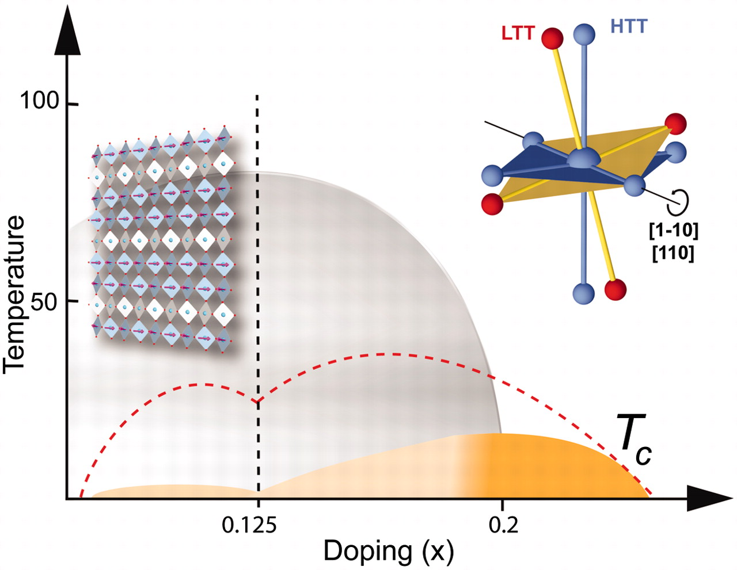
Experimental motivation: competing orders
Stripe-ordered LESCO
NbSe2
YBCO-LCMO heterostructure
CDW
SC
A. Frano et al.,
Nat. Mater. 15, 831 (2016)
D. Fausti et al.,
Science, 331, 189 (2011)
X. Xi et al., Nat. Nanotechnol. 10, 765 (2015)
Stripe-ordered LBCO
D. Nicoletti et al.,
PRB 90, 100503 (2014)

Slide 33
Driven SC/CDW
CDW ~ A
1-photon resonance
SC ~ A²
2-photon resonance
Tsuji&Aoki, PRB 92, 064508 (2015)
Cea et al., PRB 93, 180507 (2016)
Ω
Ω
2Δ
2Δ
Ω
CDW
... laser lifts SC/CDW degeneracy
... Goldstone-like collective mode?
SC

Slide 34
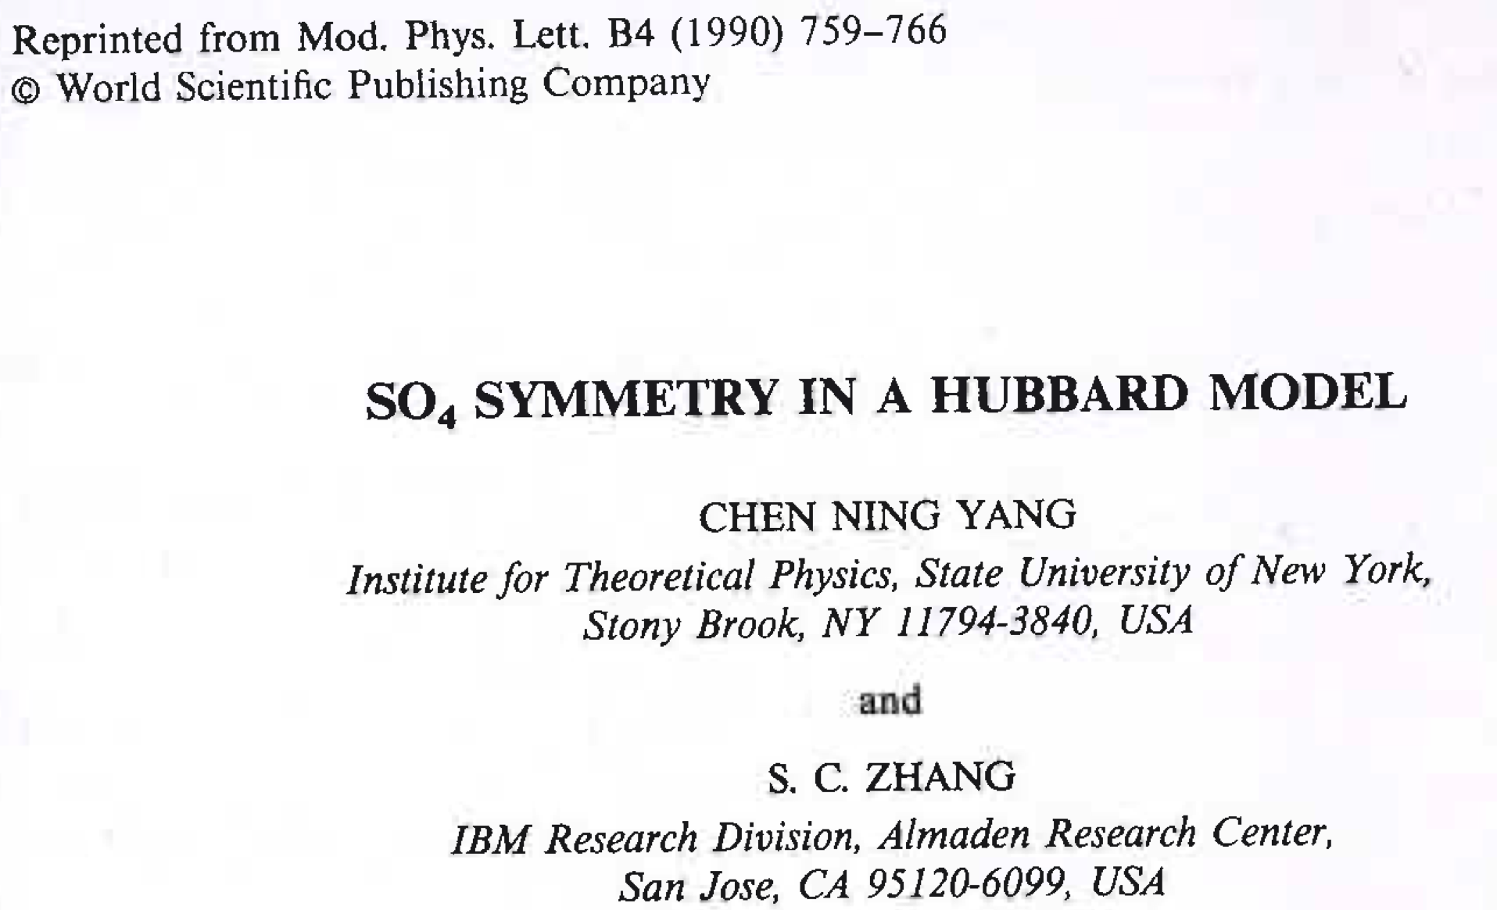
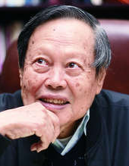
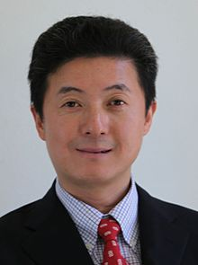
Competing orders
CDW
- attractive -U Hubbard model
- degeneracy of SC and CDW at perfect nesting
- SO(4) symmetry (SC, CDW, eta pairing)
SC
C. N. Yang
S.-C. Zhang

Slide 35

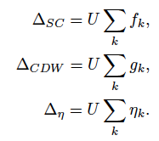
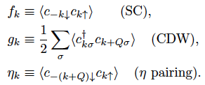
Minimal Model
2D square lattice + attractive U + mean-field decoupling

Slide 36
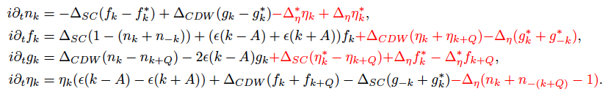
Mean-field equations
Equations of motion for electronic driving:
eta pairing provides coupling
nonlinear equations:
self-consistency in real time
Nonequilibrium:
Periodic driving field: A(t) = A_{max} sin(ωt) (e_{x} + e_{y})
A_{max} = 5 x 10⁻⁵, E_{max} ~ 10-100 V/cm – weak fields!

Slide 37
Gap resonance – coexisting initial state
Below resonance:
SC down, CDW up
CDW
SC

Slide 38
Gap resonance – coexisting initial state
Above resonance:
SC up, CDW down
CDW
SC

Slide 39

Gap resonance – coexisting initial state
„Floquet time crystal“??

Slide 40
Gap resonance
oscillation frequency set by light-induced eta pairing amplitude, which gives „mass“ to collective mode
resonant behavior at Ω=2Δ = single-particle gap

Slide 41
Inducing superconductivity
99% CDW initial state
Drive slightly above gap
SC comes alive!
Irregular behavior for stronger driving

Slide 42
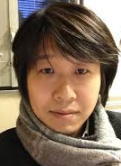
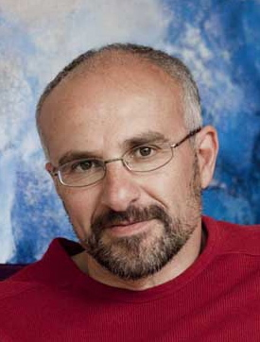
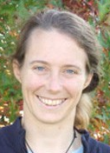
Summary III
Tight-binding model + time-dependent mean-field theory:
laser-controlled switching between SC/CDW
path to understanding of light-induced superconductivity in systems with competing orders?
  Phys. Rev. Lett. 118, 087002 (2017)
Akiyuki Tokuno Antoine Georges Corinna Kollath
Palaiseau/Paris/Geneva University of Bonn

